Slide 1
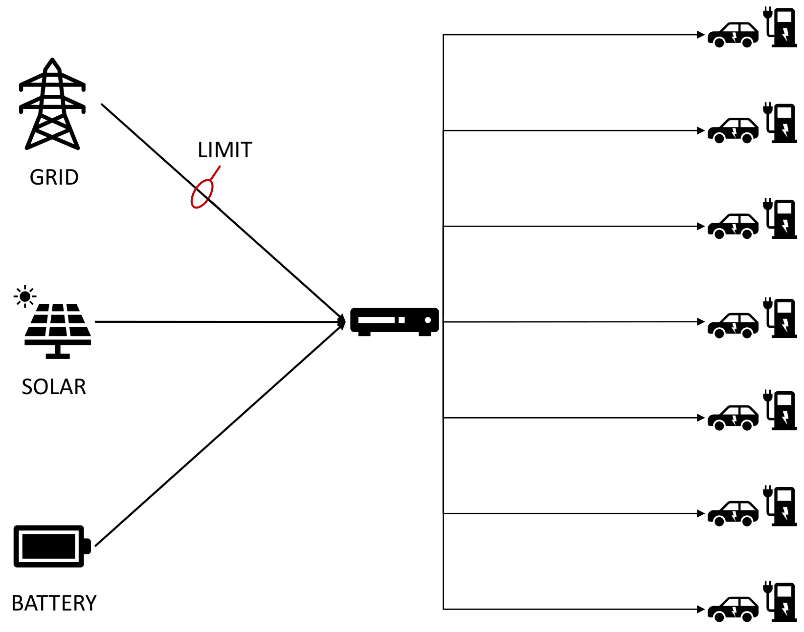
Electric Grid Analysis

Slide 2
Dataset Exploration
Comparison with Ground Truth rules:
Limited dataset (no instances above 80%)
Battery doesn’t operate at full capacity
Still providing power at SOC < 15%
Overall ~16% compliance

Slide 3
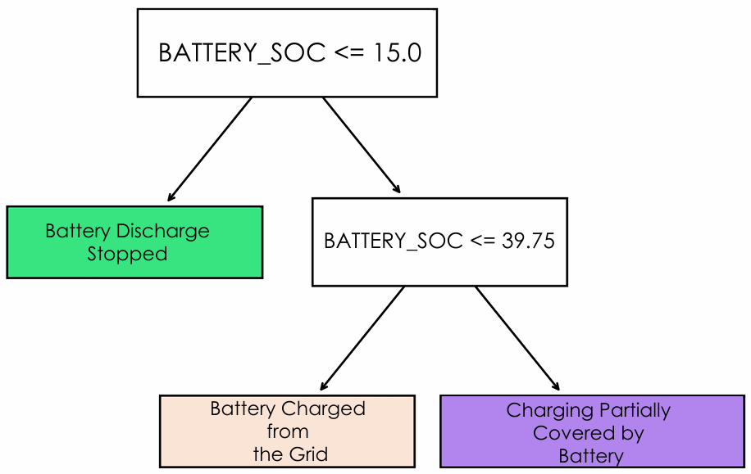
Baseline Models
Shallow decision trees
Trained on the entire dataset and cleaned subset
Extracted thresholds agree with ground truths
Interesting: Bootstrapping reveals important features
Fast-charger power
Solar power (time of day)

Slide 4
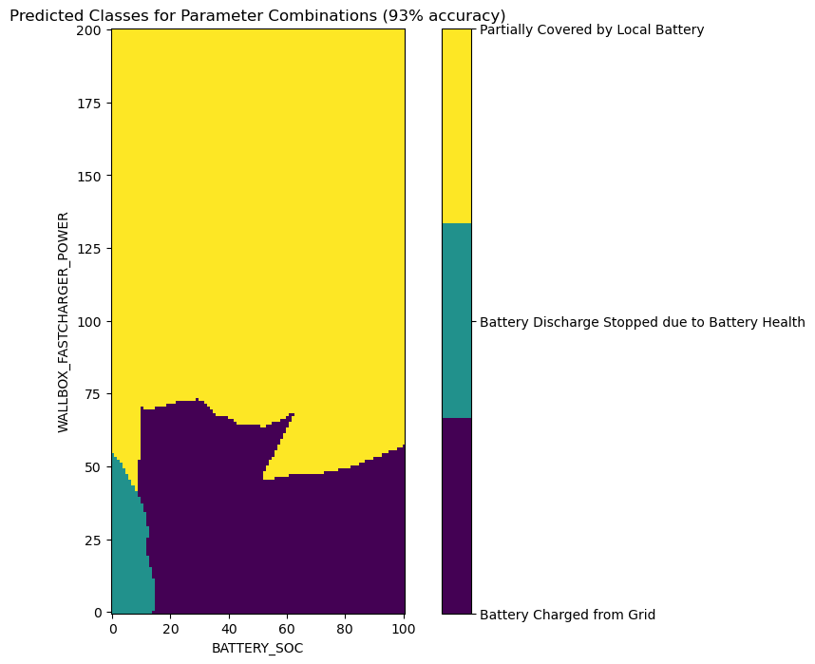
Neural Network Approach
Poor generalization of baseline model to the entire dataset – 13%
Fully connected MLP (100, 52, 52)
Improved thresholds with better performance
Two parameter model generalizes with 93% accuracy

